Slide 1

OCR-Based Multilingual Content Translator ( Summarize, and Text-to-Speech)
Title : OCR, Translate, Summarize, and Text-to-Speech Tagline: : Breaking Language Barriers with AI-Powered Text Extraction and Translation Team Name : paradox Hackathon Name : Delta headlines Date : 13/03/2025

Slide 2
Problem Statement
Extracts text from e-newspaper article images using OCR.
Summarizes the extracted text to focus on key points.
Transforms the summary into a news report format using prompt engineering.
Converts the news report into human-like audio for a realistic experience.
Goal :
To build a pipeline (website or application) that delivers engaging, AI-generated wartime news reports with audio.

Slide 3
Solution and key features
Solution :
Extracts text from images using OCR.
Translates the text into 50+ languages.
Summarizes the text for quick understanding.
Converts the summary into audio for accessibility.
Key features :
Multilingual Support: Works with over 50 languages.
Text-to-Speech: Converts text into natural-sounding audio.
User-Friendly Interface: Built with Streamlit for seamless interaction.

Slide 4

Technology Stack
Pytesseract: For Optical Character Recognition (OCR).
Deep Translator: For text translation using Google Translate API.
gTTS: For converting text to speech.
Streamlit: For building the web interface.
Why These Technologies used?
Open-source
Easy to integrate
Highly scalable.

Slide 5
How It Works
Upload Image: Users upload an image containing text.
OCR Processing: Extract text using Tesseract OCR.
Language Translation: Translate the text into the desired language.
Text Summarization: Generate a concise summary of the translated text.
Text-to-Speech: Convert the summary into an audio file for playback or download.

Slide 6
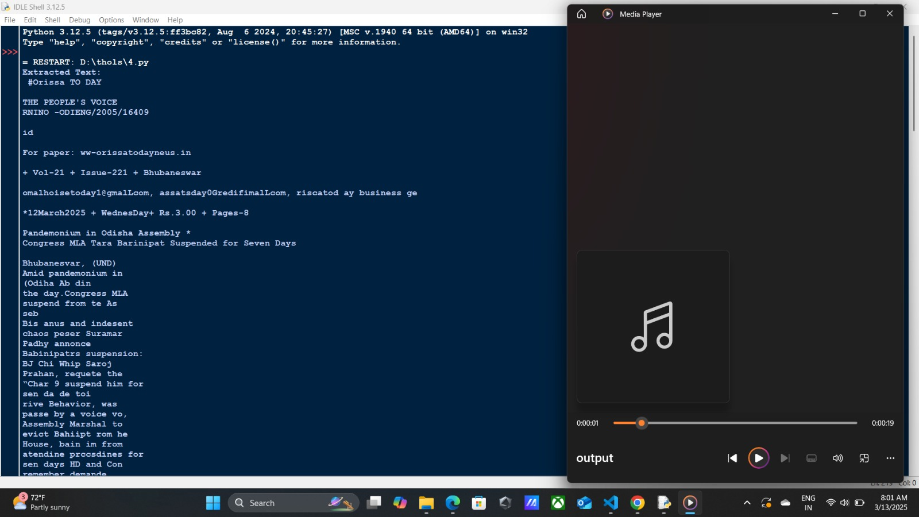

Slide 7
Challenges
OCR Accuracy: Low-quality images can lead to errors.
Language Support: Some languages are not fully supported.
Audio Quality: Text-to-speech may not sound natural for all languages.

Slide 8
Future Enhancements
Advanced Image Preprocessing: Add options for image enhancement (e.g., brightness, contrast).
Support for More Languages: Expand language support for OCR and translation.
Integration with Cloud Services: Use cloud-based OCR and translation APIs for better scalability.
Mobile App Version: Develop a mobile-friendly version of the application.

Slide 9
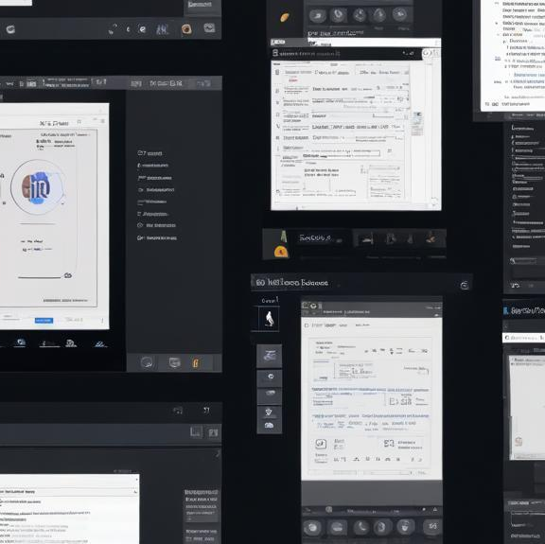
conclusion
Who Benefits?
Travelers: Read signs and documents in foreign languages effortlessly.
Students: Translate and summarize academic materials for better understanding.
Visually Impaired Users: Listen to text from images, making information more accessible.
Businesses: Process multilingual documents efficiently, saving time and resources.
"This program demonstrates the power of Python for automating tasks like text extraction, summarization."
"It can be extended to support more languages, improve summarization algorithms."

